Slide 1
Operating system and system programming (25CS2104E)
LINUX FILE SYSTEM EXPLORER USING SYSTEM CALLS
Under the Esteemed Guidance of
Raghupathi M
CSE Department
Team Members:
Usharani – 2520090049
Koumudi – 2520090161
Mrudhula - 2520090073

Slide 2
Contents
Abstract
Introduction
Hardware and Software requirements
System Architecture
Methodology
Code Screenshots
Output Screenshots
Conclusion

Slide 3
Abstract
The Linux File System Explorer Using System Calls is a command-line based Linux system programming project developed in C to provide an interactive way to explore and manage files and directories. The main objective is to demonstrate important Operating System and Linux/POSIX concepts such as system calls, file descriptors, file I/O, directory management, file permissions, metadata, and error handling. The proposed system allows users to perform operations such as viewing and navigating directories, creating, reading, writing, renaming and deleting files, creating and removing directories, searching for files, and viewing information such as file size, permissions, ownership, and modification time. The application will use Linux/POSIX system calls and APIs including open(), read(), write(), close(), mkdir(), rmdir(), unlink(), rename(), stat(), chdir(), getcwd(), opendir(), readdir(), and closedir(). Proper validation and error handling will be included to ensure reliable execution. The expected outcome is a functional Linux file-system explorer that demonstrates how user-level programs interact with the Linux operating system and kernel through system-level interfaces, providing practical experience in systems programming.

Slide 4
Introduction
The Linux File System Explorer Using System Calls is a system programming project designed to provide a command-line interface for exploring and managing files and directories in a Linux environment. File management is one of the fundamental responsibilities of an operating system, and Linux provides various system calls and POSIX APIs through which applications can interact with the file system. This project focuses on understanding these low-level mechanisms by implementing common file and directory operations directly through system-level interfaces. Users can navigate directories, list files, create and delete files and directories, read and write file contents, rename files, search for files, and view file metadata such as size, permissions, ownership, and modification time. The project is developed using C programming on Linux/Ubuntu and demonstrates important Operating System concepts including system calls, file descriptors, file I/O, directory handling, permissions, metadata, and error handling. Unlike a generic file-management application, the core functionality of the project is implemented using Linux/POSIX mechanisms to demonstrate how user programs communicate with the operating system.

Slide 5
Hardware and Software requirements
List the Requirements in table format
Hardware | Software
Laptop/computer | Linux/ Ubuntu
Intel core i3 or above | C Programming language
Minimum 4GB Ram | GCC Compiler
Minimum 10GB free storage | GNU Make
Keyboard | Bash terminal
Monitor | VS Code/ Vim/ Nano
---- | Linux/ POSIX APIs
---- | Git & GitHub

Slide 6
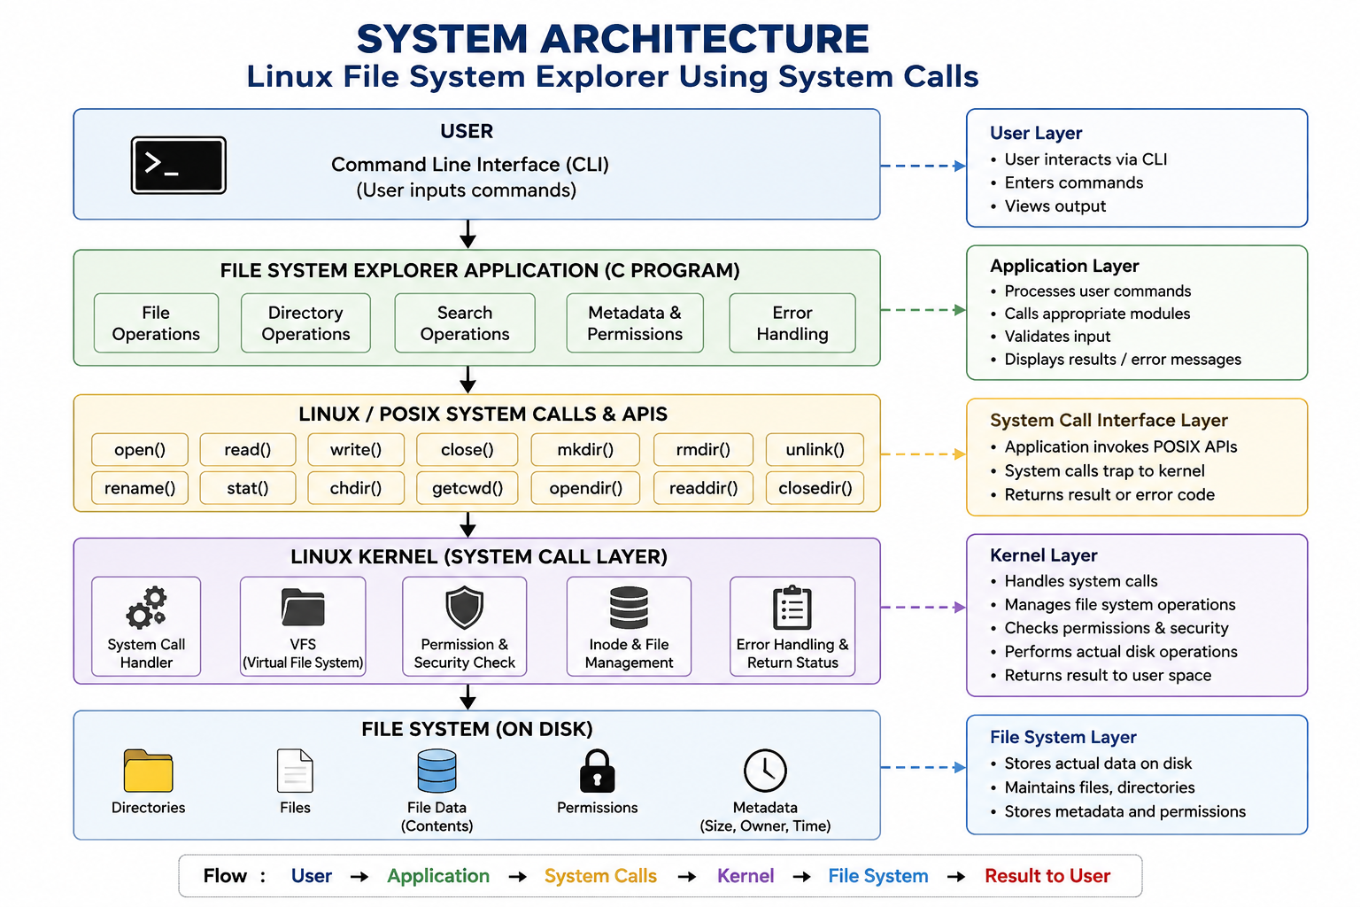
System Architecture

Slide 7
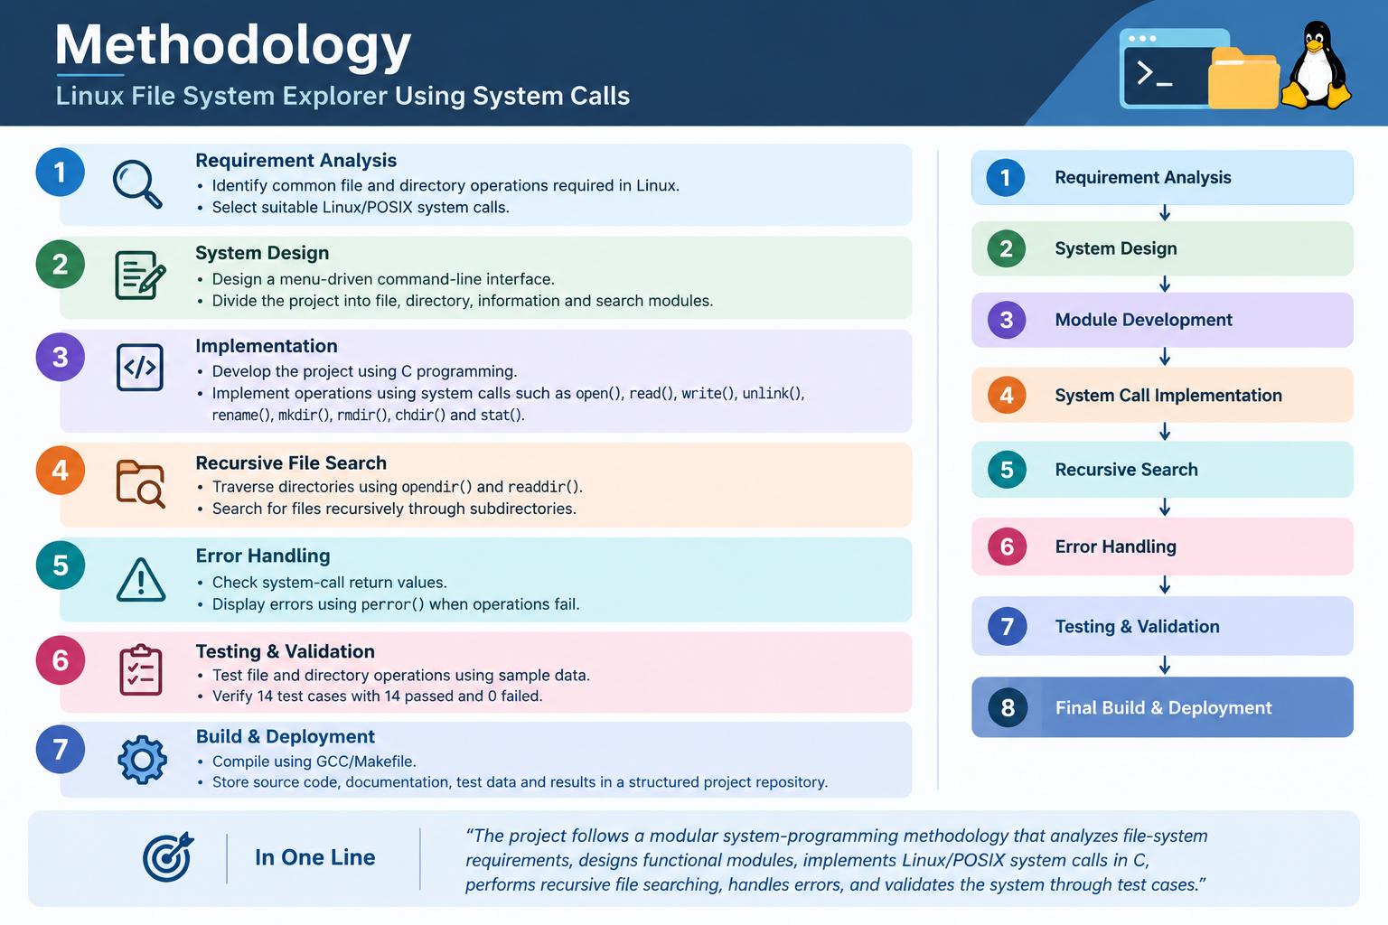
Methodology

Slide 8
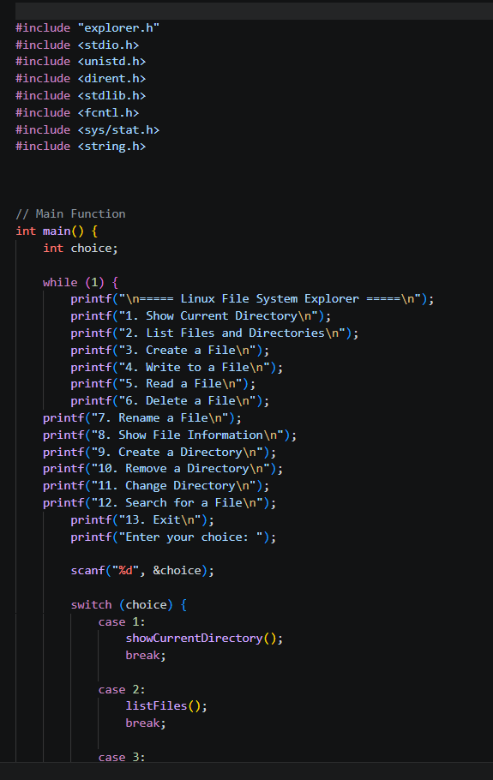
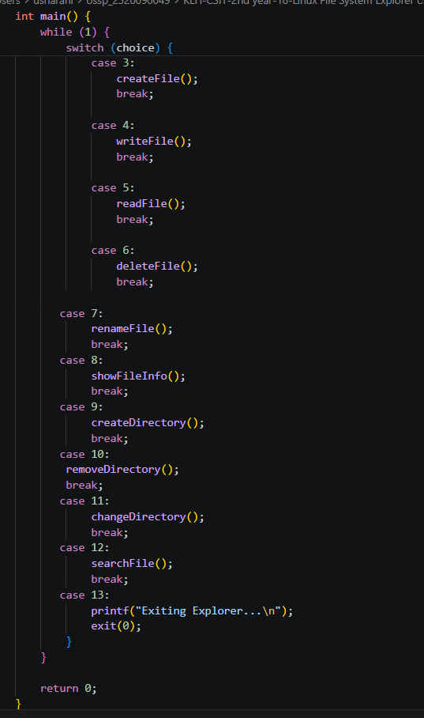
Code Screenshots

Slide 9
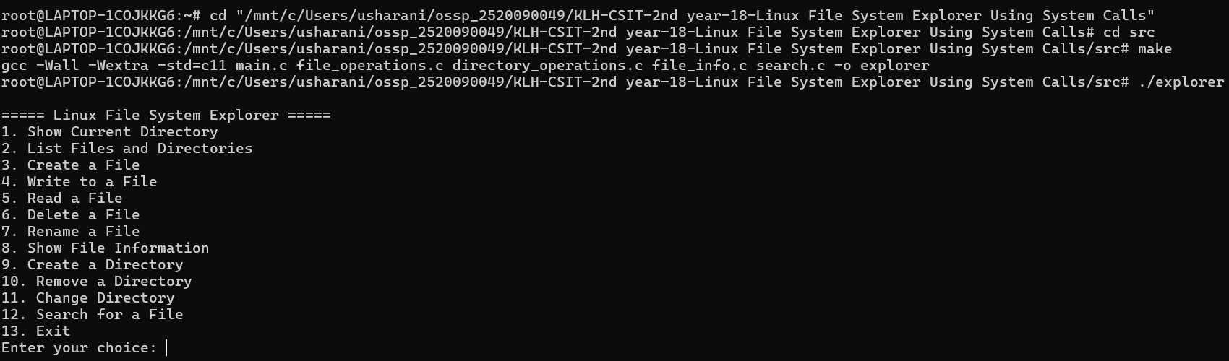
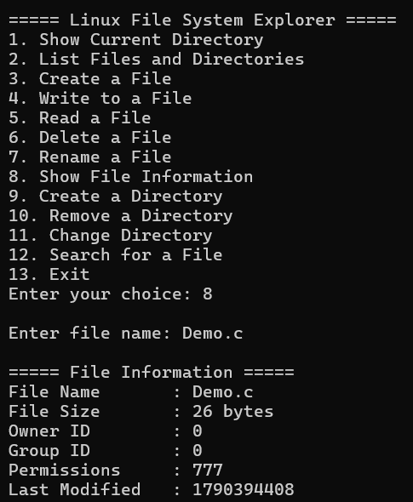
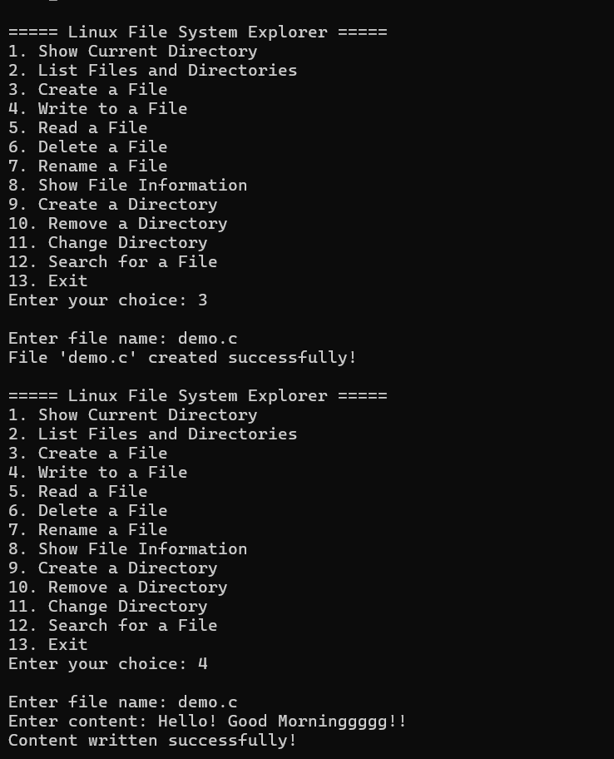
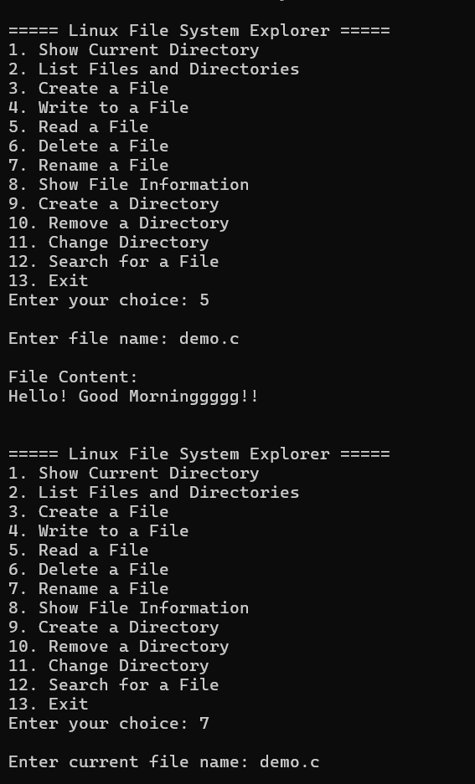
Output Screenshots

Slide 10
Project Feasibility Analysis
Developed using C programming.
Runs on Linux/Ubuntu or WSL.
Uses standard Linux/POSIX system calls.
Requires only a standard computer.
Uses GCC and Makefile for compilation.
Easy to test using sample files and directories.

Slide 11
Thank you

